Slide 1

Chat-Now

Slide 2

Introduction
This chat app has been designed to revolutionize how you connect with others. Seamlessly blending modern design with powerful functionality, our app offers real-time messaging and group chats for an immersive communication experience. Join us and elevate your conversations to a whole new level.

Slide 3
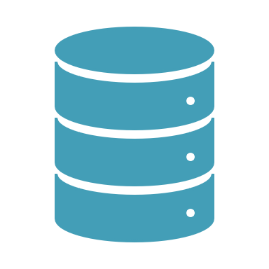
Tech Stack Used
MERN, an acronym representing MongoDB, Express.js, React.js, and Node.js, comprises a powerful stack of technologies integral to modern web development. Each component plays a crucial role in the development process, contributing to the creation of dynamic, scalable, and efficient web applications
M-> MongoDB
E-> ExpressJS
R-> ReactJS
N-> NodeJS

Slide 4

MongoDB
MongoDB serves as the cornerstone of the MERN stack, offering a flexible, schema-less approach to data storage through its NoSQL database model. It stores data in JSON-like documents, facilating seamless integration with Node.js applications and providing scalability to accommodate growing data needs.

Slide 5

ExpressJs
Express.js, a minimalist and flexible web application framework, simplifies the process of building server-side applications in Node.js. It provides a robust set of features for handling HTTP requests, routing, and middleware, empowering developers to create RESTful APIs and efficiently manage server-side logic.

Slide 6

ReactJS
React.js, a declarative and component-based JavaScript library, revolutionizes the development of user interfaces. It enables developers to build interactive and responsive UI components for single-page applications (SPAs), enhancing code reusability and facilitating the efficient updating of the UI in response to data changes.

Slide 7
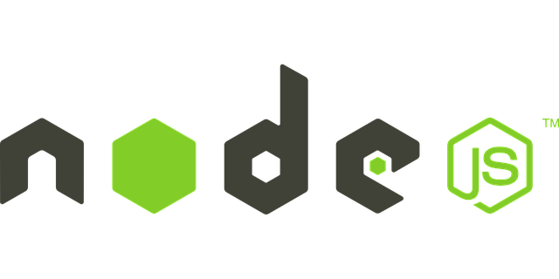
NodeJS
Node.js, a JavaScript runtime environment, extends the capabilities of JavaScript beyond the confines of the web browser. It enables server-side JavaScript execution, leveraging its non-blocking, event-driven architecture to build scalable and high-performance web applica1ons.

Slide 8
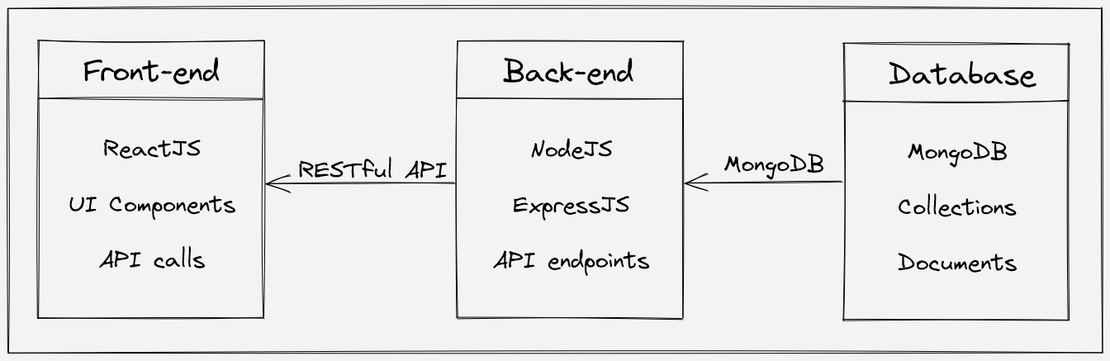
Architecture Diagram
Frontend: UI design, client logic, communicates with backend for interaction.
Backend: Server logic, database interaction, security implementation for functionality.
Database: Data storage, integrity maintenance, accessed by backend operations.
Communication: Facilitates interaction, data processing between frontend and backend components.

Slide 9
Backend Features And Functionalities
-> User Authentication & Authorization
-> Chat Collection
-> Cloud Storage for Media

Slide 10
Modules Used In The Backend
Dotenv
Bcrypt
Mongoose
Json-web-token
Nodemon
Express-async-handler
Cloudinary

Slide 11
Modules Used In The Backend
Bcrypt: Backend library enhances security by hashing passwords cryptographically for protection.
Mongoose: Elegant MongoDB object modeling for Node.js applications effortlessly integrated.
Cloudinary: Streamline, optimize, and manage media assets effortlessly and efficiently.
Express-async-handler: Middleware for Express.js that simplifies error handling for asynchronous route handlers

Slide 12
JsonWebToken: Token-based authentication mechanism securing web applications efficiently and effectively.
Express: Efficient web application framework for Node.js development seamlessly integrated.
Dotenv: Simplifies environment variable management, enhancing configuration process effortlessly in Node.js.
Nodemon: Automates server restarts upon file changes for efficient development.

Slide 13
Sample API Endpoints and Functionalities
/api (POST) - Create a new user account.
/api/auth/login (POST) – Log in using existing credentials.
/api (GET) – Get the list of all existing users.
/api/auth/sendMessage (POST) – To send the message in a chat.
/api/:chatId (GET) – Get all the messages related to that chatId.
/api/fetchChat (GET) - Get all the chats.
/api/group (POST) - Create a new Group Chat.
/api/rename (PUT) - Update the name of an existing Group Chat.
/api/groupremove (PUT) - Delete a user from the Group Chat.
/api/groupadd (PUT) - Add a user into Group Chat.

Slide 14
Sample API Requests and Responses
GET /api – Get the list of all existing users.
GET /api/:chatId– Get all the messages.
POST /api - Create a new user account
PUT /api/rename - Update the name of an existing Group Chat

Slide 15
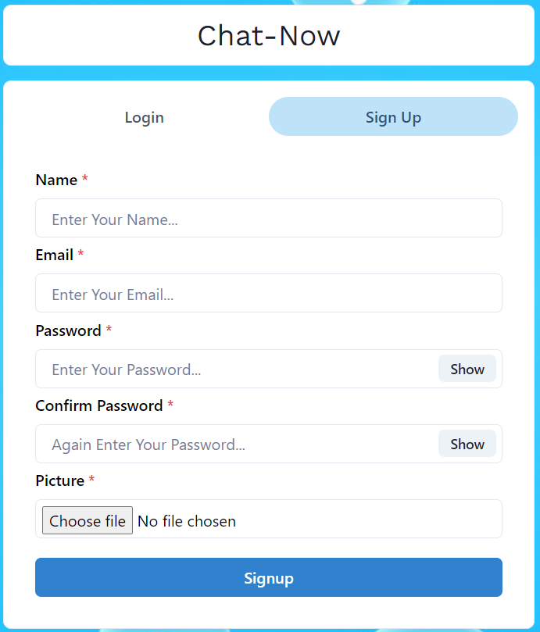
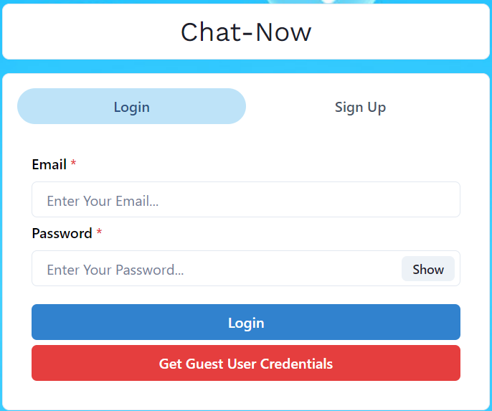

Slide 16
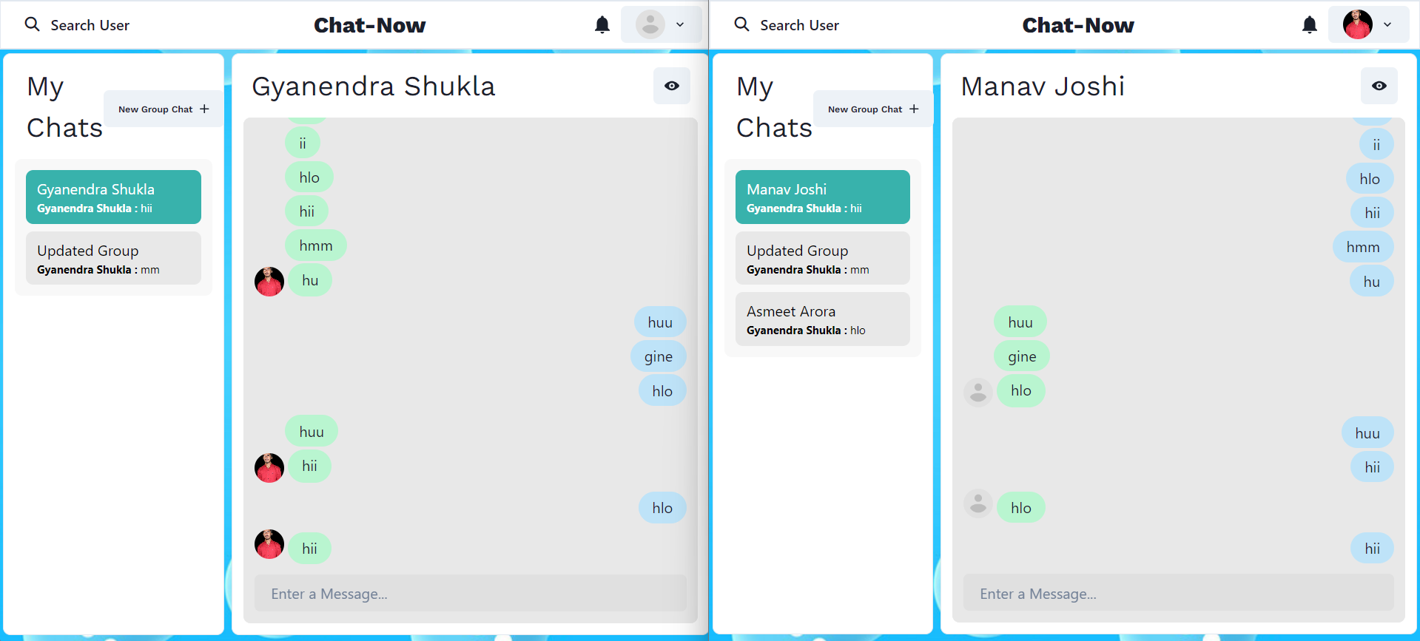

Slide 17
THANK YOU

